Slide 1

STRUCT Project

Slide 2

About the team
Name | Role
Aleksandar Galinov Dinev – IX V | Manager
Dimitar Milenov Kalchev – IX A | Designer, Developer
Aleksandar Kostadinov Patrashkov – IX B | Designer, Developer
Kaloyan Nikolaev Andrikov – IX G | Designer, Developer

Slide 3
About our project
Nowadays more and more organizations start creating events which include tournaments of online games like League of Legends, Counter-Strike: Global Offensive and others.
The main idea of our project is to help event creators to deal easier with the tournament management.
We have created a C++ application that gives the opportunity to the tournament administrators to add, delete and edit their tournaments.

Slide 4


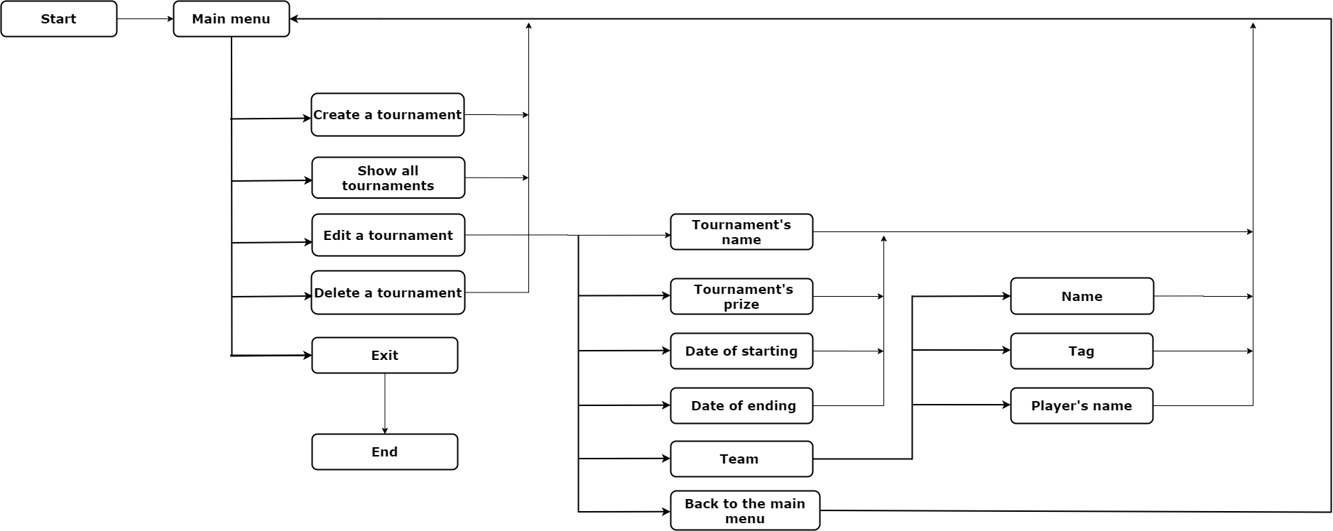
logical SCHEME of our application

Slide 5


Used technologies

Slide 6
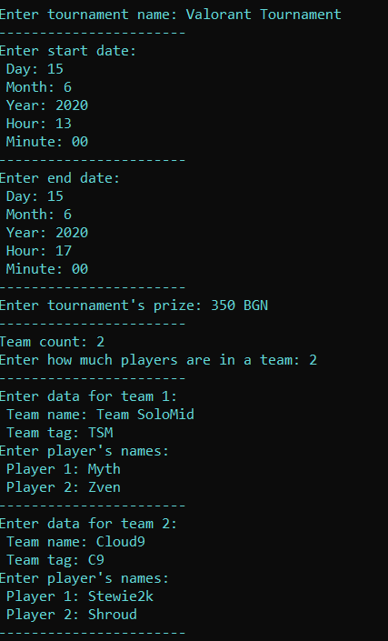
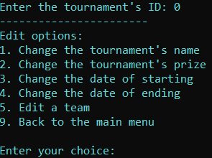
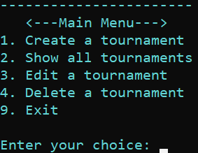
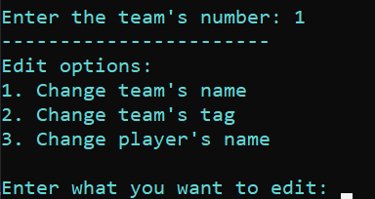
Parts of our application's menu

Slide 7
future improvements
In the future we want to:
add a better interface
add a bracket maker
make the program easier to work with

